Slide 1
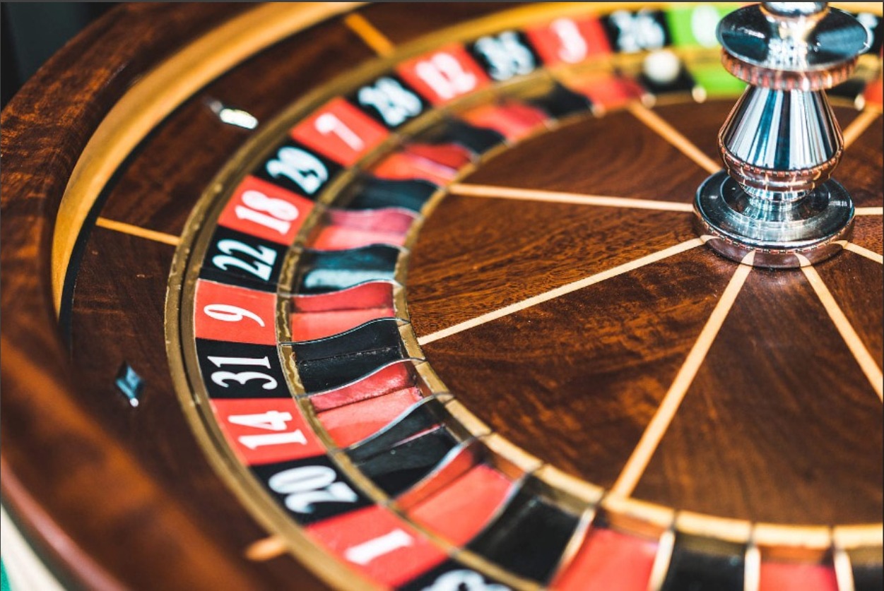
Casino game using Matlab
Develop by sneha padma
b.tech,2nd year,Sec-a
Enrollment no.:12022002001152
University of engineering & management Kolkata

Slide 2
Statement
Develop a MATLAB-based casino game simulation that offers users an interactive and entertaining experience,
including popular casino games such as blackjack, and slot machines, with realistic graphics and gameplay mechanics

Slide 3
Objective
The primary objective of this casino game project is to create an engaging, realistic, and educational gaming experience in MATLAB
The project's focus is on combining interactivity and educational value to offer a comprehensive and enjoyable user experience.

Slide 4
Design :
for Design The Casino Game :
I Used "MATLAB APP DESIGNER TOOL”
In APP Designer Tool
I Used :
1 Gauge
5 Label(including Words)
1 Button(including Words)
1 Spinner(including Number)

Slide 5
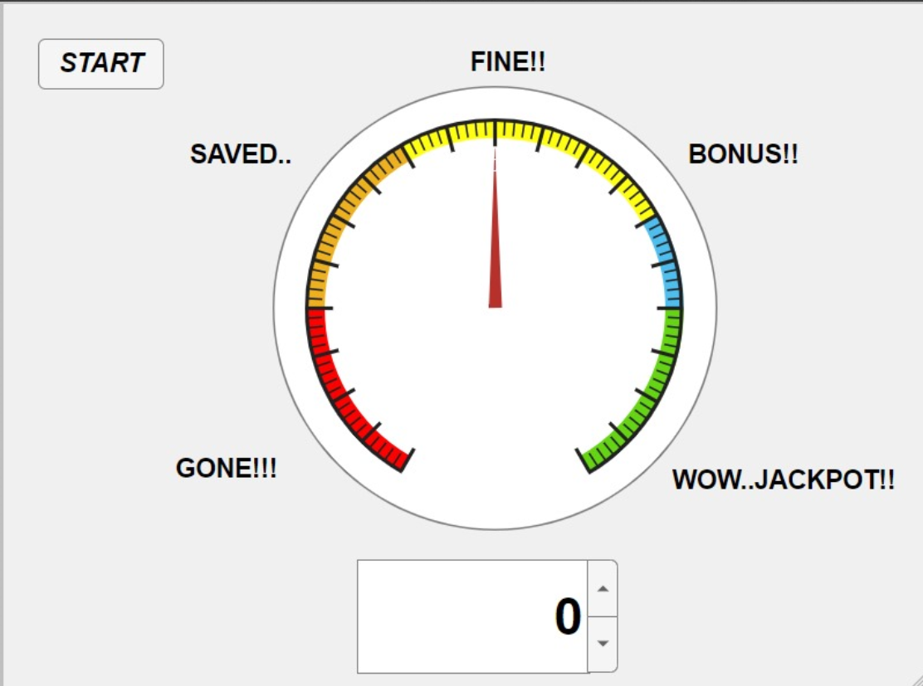
App Design :

Slide 6
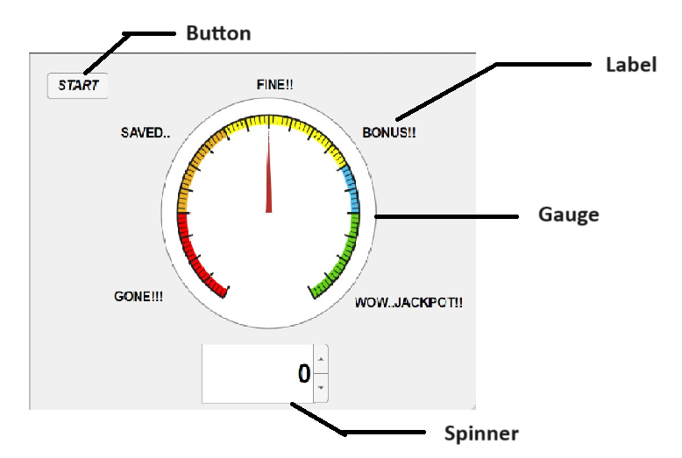
Tools Design:

Slide 7
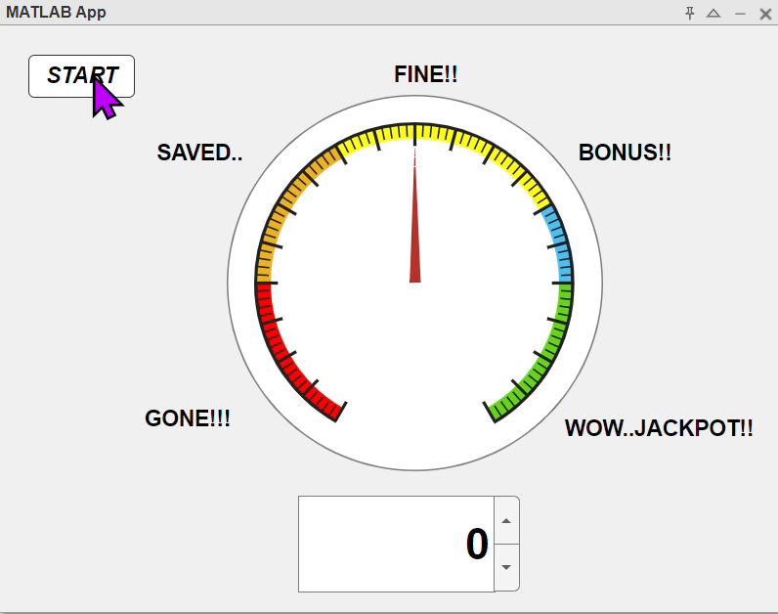
Procedure
Tap to the start button,the tick will start moving for 20sec then the tick will indicate any of the label like fine or saved,bonus etc.
Just cross your finger with excitement and lets see what will be the outcome

Slide 8
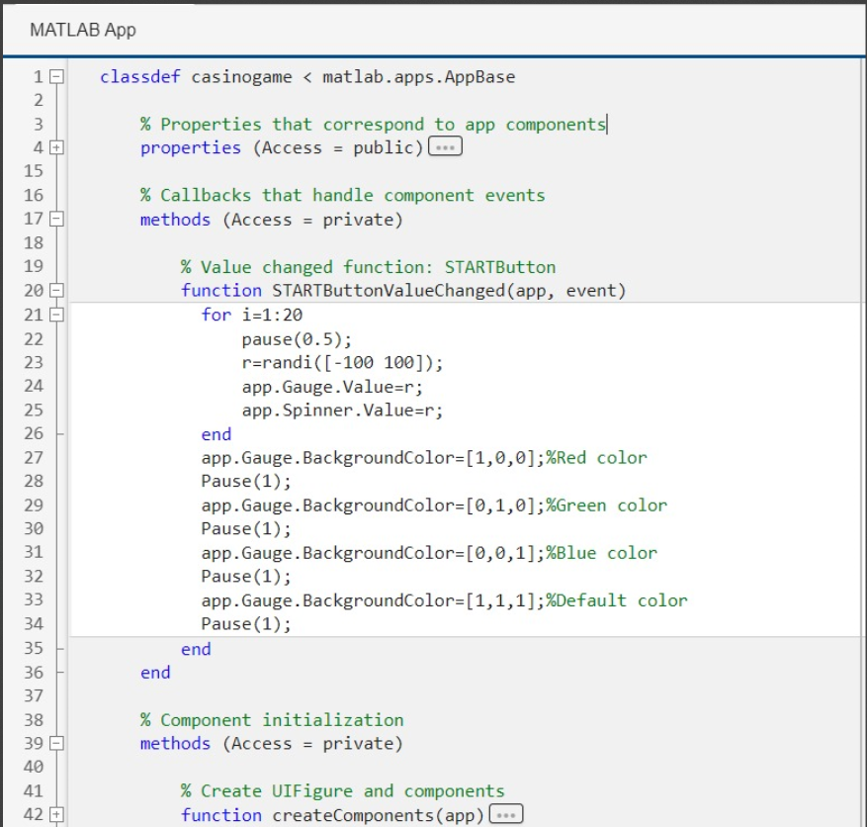
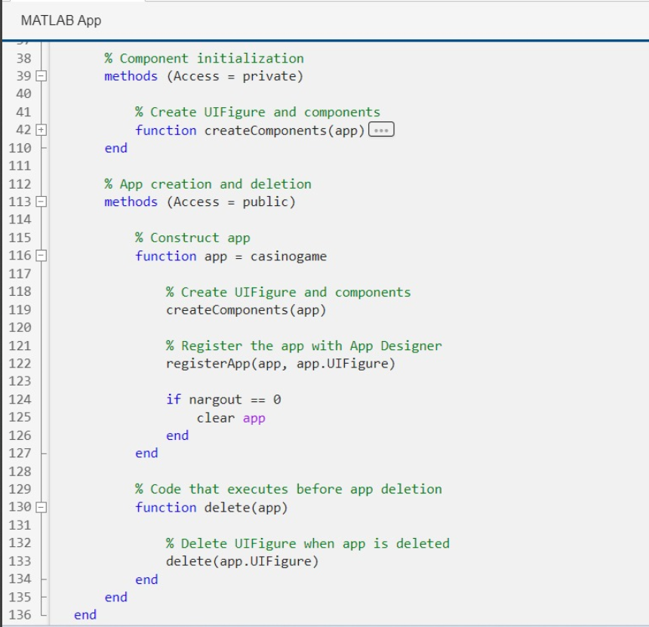
Code

Slide 9
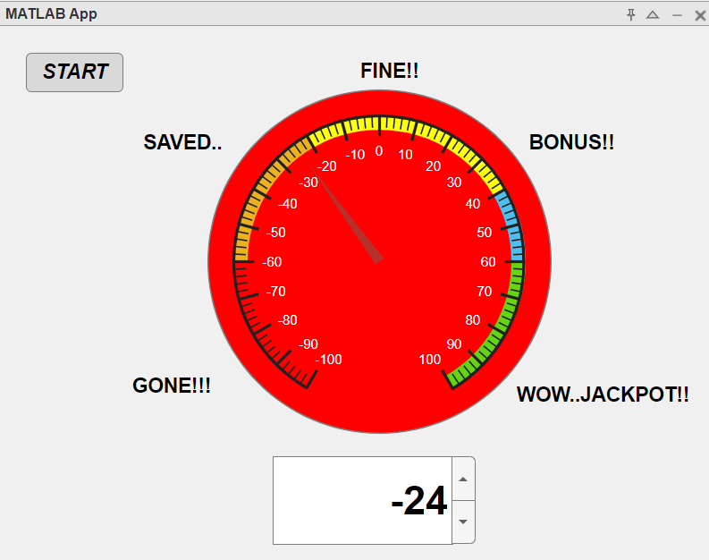
Output

Slide 10
Outcome
Engaging Gameplay: This game provides an engaging and immersive experience, with a moving tick that adds an element of suspense to every play.
Visual Appeal: The game's graphics and visual elements enhance the overall experience, making it visually appealing and enjoyable
Fair and Random Outcomes: We've ensured the fairness of the game through carefully designed random number generation, allowing players to enjoy a truly random and unbiased experience.
Our Casino Game project not only demonstrates our technical proficiency but also our commitment to delivering a fun and entertaining experience to our users. We hope this game brings joy and excitement to those who play it and serves as a testament to the potential of MATLAB for game development.

Slide 11
T H A N K Y O U

